Slide 1

KISHKINDA UNIVERSITY
TEAM MEMBERS:
JUNAID AHMED
NAYEEM
S M MOHAN
AMAN
DHANUSH
TOPIC: “STADIUM CONCESSION MANAGEMENT”

Slide 2
“STADIUM CONCESSION MANAGEMENT”
EXPLAINATION:
"Management Stadium Concession" refers to a trial project (Proof of Concept) for managing food and beverage sales at a stadium. It focuses on testing how efficiently the system works. This includes tracking orders, payments, and inventory at concession stands. The goal is to ensure smooth operations during live events".

Slide 3
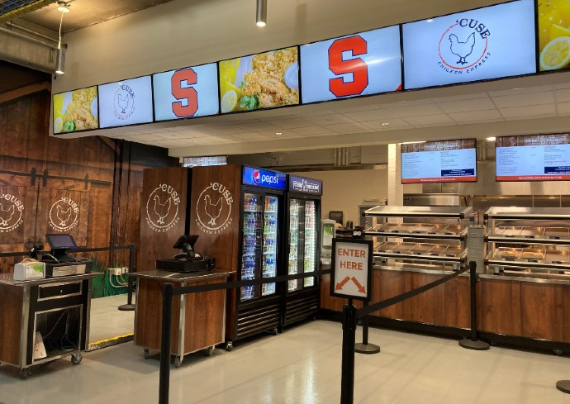
INTRODUCTION:
1. Track available food items.
2. Manage inventory levels.
3. Record sales transactions.
4. Update stock after each sale.
5. Generate sales reports.

Slide 4
OBJECTIVE:
Here are the objectives for the Stadium Concession Management POC:
1. Improve Inventory Accuracy – Track and update inventory in real-time.
2. Optimize Sales Tracking – Record and manage sales for better performance analysis.
3. Ensure Stock Availability – Send alerts when items are low or out of stock.
4. Streamline Ordering Process – Simplify reordering and restocking of items.
5. Increase Sales Efficiency – Speed up sales transactions and reduce errors.

Slide 5
ADVANTAGES:
Data Management: Python can handle large datasets efficiently, allowing for effective tracking of inventory, sales, and customer preferences.
Real-Time Analytics: Implementing real-time analytics helps in monitoring sales trends, peak times, and popular items, enabling informed decision-making.
Automated Inventory Control: Python can automate inventory tracking, reducing the risk of stockouts or overstocking and ensuring timely replenishment.
Improved Customer Experience: By analyzing customer data, businesses can personalize offerings, optimize menu items, and reduce wait times through better resource allocation.
Cost Reduction: Automating processes like ordering, billing, and reporting can lower labor costs and minimize human error.
x

Slide 6
DISADVANTAGES:
. Performance Limitations: Python can be slower than compiled languages (like C or Java), which might affect performance in high-demand scenarios, especially with real-time processing.
Concurrency Challenges: Python’s Global Interpreter Lock (GIL) can limit multi-threaded performance, making it challenging to efficiently handle multiple requests simultaneously.
Dependency Management: Managing dependencies can become complex, especially in larger applications, leading to compatibility issues or difficulties in updating libraries.
Limited Mobile Support: While Python is great for server-side applications, it may not be the best choice for mobile applications without additional frameworks, which can complicate the tech stack.
Resource Consumption: Python applications can consume more memory than applications written in lower-level languages, which might be a concern for systems with limited resources.

Slide 7
Future enhancements of stadium concession and management :
1. Mobile Ordering & Contactless Payments: Fans will use apps to pre-order food and drinks for delivery to their seats or express pick-up, reducing wait times.
2. AI & Data Analytics: AI will analyze fan preferences and real-time demand to optimize inventory and staffing, leading to better service and cost savings.
3. Sustainability: Expect a shift toward eco-friendly packaging, energy-efficient equipment, and reduced food waste through better forecasting.
4. Self-service Robots: Automated robots may handle food preparation and distribution, reducing reliance on staff.
5. Personalized Experiences: Concessions might offer customized menus based on fan preferences tracked through loyalty programs or apps.

Slide 8
Vision: To create an exceptional fan experience through premium, convenient, and innovative concession services.
Mission: To deliver diverse, high-quality food and beverages efficiently, while maximizing customer satisfaction, safety, and profitability in stadium events.

Slide 9
CONCLUSION:
Stadium concession management involves organizing food and drink services efficiently during events. It ensures quick service, good quality, and availability of popular items to satisfy attendees. Effective management helps reduce waiting times and improves customer experience. This leads to increased sales and overall profitability for the stadium.

Slide 10
REFERENCE: CHATGPT
THANK YOU

